Slide 1
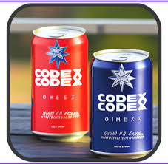
Actionable Insights to Drive Codex's Indian Journey
BY SANCHITA DASGUPTA

Slide 2
contents
PROBLEM STATEMENT
PRIMARY ANALYSIS & INSIGHTS
SECONDARY ANALYSIS & INSIGHTS
THANK YOU

Slide 3
PROBLEM STATEMENT
CODEX, a German beverage company, is striving to establish a strong presence in the Indian market. A few months ago, they launched their energy drink in 10 cities across India.
The Marketing team is focused on increasing brand awareness, capturing market share, and driving product development. To support these efforts, they conducted a survey in these 10 cities, gathering responses from 10,000 participants. A team of marketing analysts has been tasked with analyzing the survey results to uncover meaningful insights that can guide strategic actions.

Slide 4
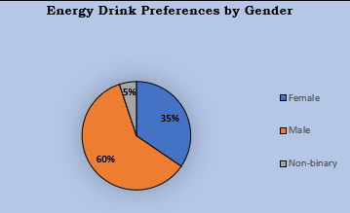
PRIMARY ANALYSIS [DEMOGRAPHIC INSIGHTS]
Who prefers energy drink more? (male/female/non-binary)?
INSIGHTS: Males tend to prefer energy drinks more, likely due to their engagement in activities such as athletics, gym workouts, and the need for mental alertness or extended focus during long hours of work or study.

Slide 5
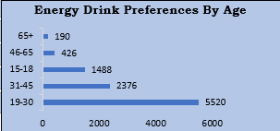
Which age group prefers energy drinks more?
INSIGHT: Among 10,000 consumers, more than 5,000 energy drink consumers belong to the youth age group of 19-30. This age group shows the highest preference due to their active lifestyles, including athletic activities, exercise routines, studying, and working long hours.

Slide 6
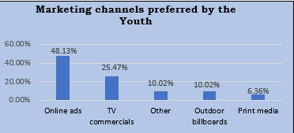
Which type of marketing reaches the most Youth (15-30)
INSIGHT: Youth prefer online ads because they are more engaged with social media and rely heavily on mobile phones compared to other methods.

Slide 7
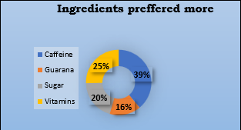
Consumer Preferences
What are the preferred ingredients of energy drinks among respondents?
INSIGHT: Caffeine is a highly prioritized ingredient, as studies show it helps maintain alertness and provides an instant energy boost.

Slide 8
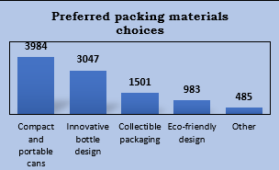
What packaging preferences do respondents have for energy drinks?
INSIGHT: Compact and portable are most preferred packing materials as it is easy to carry anywhere less space oriented.

Slide 9
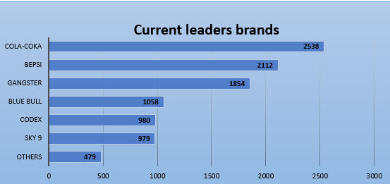
Competition Analysis
Who are the current market leaders?
INSIGHT: Here are the top competitors dominating the Indian market ahead of Codex Energy Drinks:
Cola-Coka, Bepsi, Gangster, and Blue Bull.

Slide 10
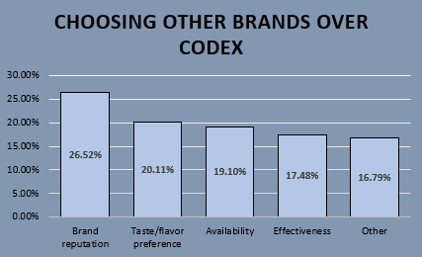
What are the primary reasons consumers prefer those brands over ours?
INSIGHT: The reason for choosing these brands over the codex is mainly Brand reputation , taste & flavour preference and availability so definitely the codex can work on its marketing team , introduces some flavours and fill up the stocks to compete with his competitors.

Slide 11
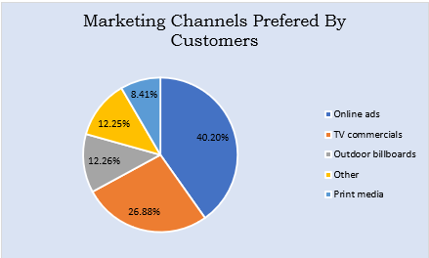
Which marketing channel can be used to reach more customers? How effective are different marketing strategies and channels in reaching our customers?
MARKETING CHANNELS
INSIGHT: Over 40% of customers prefer online ads, driven by social media growth and reels. This cost-effective strategy effectively reaches a broad audience across all age groups.

Slide 12
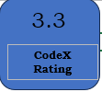
Brand Penetration:
What do people think about our brand? (overall rating)
INSIGHT:People give an average rating of 3.3, which can be improved by enhancing brand awareness, as well as focusing on better taste and quality.

Slide 13
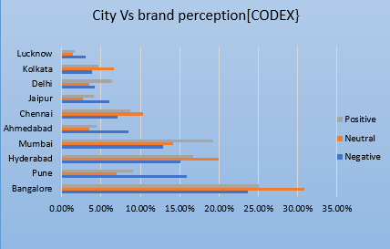
Which cities do we need to focus more on?
INSIGHT: Focus on improving neutral and negative perceptions in Bangalore, Hyderabad, Mumbai, and Ahmedabad, while sustaining positive perceptions in Kolkata, Delhi, and Jaipur.

Slide 14
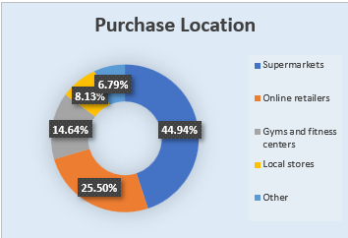
Purchase Behaviour:
WHERE DO RESPONDENTS PREFER TO PURCHASE ENERGY DRINKS ?
INSIGHT: Approximately 45% prefer supermarkets for purchasing Codex drinks, while around 25% opt for online retailers.

Slide 15
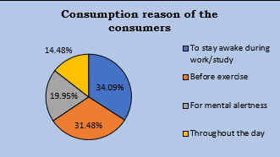
What are the typical consumption situations for energy drinks among respondents?
The Main reasons was to stay awake during work or study hours followed intake before exercise both are the primary reason to increase the stamina and will power

Slide 16
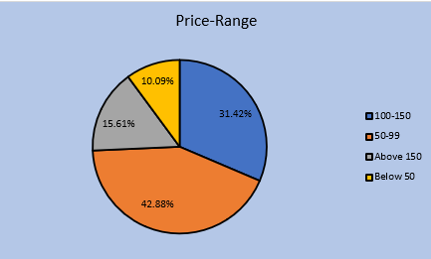
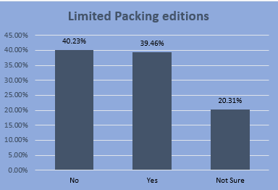
What factors influence respondents' purchase decisions, such as price range and limited- edition packaging?
INSIGHT:Approximately 43% of consumers prefer drinks priced between ₹50 and ₹99. Additionally, 40% are not expecting any changes, while around 39% are open to modifications in the limited packaging editions.

Slide 17
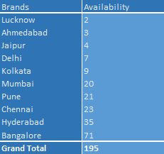
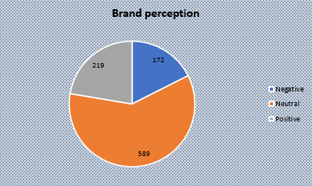
Which area of business should we focus more on our product development? (Branding/taste/availability)
INSIGHT: Out of 980 respondents surveyed for Codex, 219 shared positive feedback about the brand perception. The brand's rating aligns closely with the industry's average. However, availability needs significant attention, as approximately 20% of respondents choose brands based on their availability. This aspect should be prioritized.

Slide 18
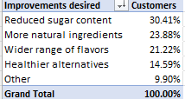

Secondary Insights:
Recommendations for Codex:
What immediate improvements can we bring to the product?
Prioritize customer health by reducing sugar content.
Incorporate more natural ingredients into the product.
Improve the availability of Codex across markets.
Increase marketing efforts to enhance brand visibility and appeal.

Slide 19
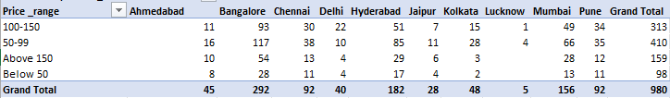
What should be the ideal price of our product?
Set the price range of Codex energy drinks between ₹50 and ₹99, as this is the preferred range among customers across all cities.
Introduce more small, portable cans to boost sales and cater to on-the-go consumption.
This approach ensures the product maintains its quality while staying within an affordable price range.

Slide 20
What kind of marketing campaigns, offers, and discounts we can run?
Based on our analysis, online ads are the most effective marketing method. Running ads on social media platforms like Facebook and Instagram is highly suitable.
Starting with reels is a cost-effective way to reach a broader audience.
Introduce influencer marketing with creators having 10K–100K followers. Begin with unpaid or barter collaborations, and as sales grow, gradually scale up to paid campaigns.
Provide regional offers during specific festivals, such as discounts in Kolkata during Durga Puja or in Mumbai during Ganesh Chaturthi.
Introduce bulk purchase discounts, e.g., offering savings when customers buy a pack of three.
These strategies will help boost Codex sales and enhance brand awareness effectively.

Slide 21

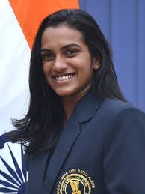
Who can be a brand ambassador, and why?
As in analysis we can see the consumption rates was typical between athletes and sport person Influencer with sports person will be effective . I have selected two person
Virat Kohli, a global cricketing icon, is one of the most famous athletes worldwide, boasting a massive following across social media platforms.
Along with that he has –
Global Recognition
Works with all kinds of brands , more famous to the youth icon
But patterning with will be expensive as he demands premium prices for his ads
PV Sindhu, an Olympic silver medalist and one of India’s most successful athletes in badminton, also has significant brand value.
Along it she has –
Primary niche on fitness and overall international badminton market
Although overall market demand is lower as compared to Kohli but can lead to more affordable pricing and also be sign of woman empowerment.

Slide 22
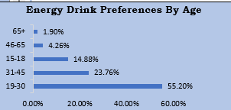
Who should be our target audience, and why?
Based on this analysis, our target audience will be individuals between the ages of 15 and 45, as this age group covers over 90% of energy drink consumption.

Slide 23
Thank
YOU

